Slide 1

COS10009 Week 7
Data References, Advanced Arrays and searching

Slide 2
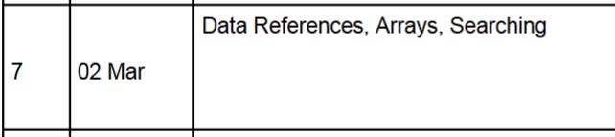
Today we will cover the following topics:

Slide 3
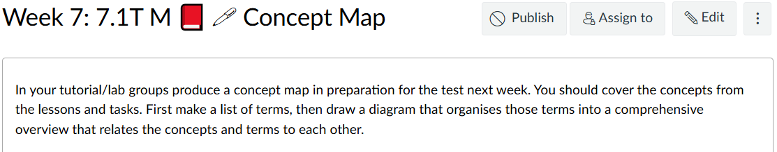
Review

Slide 4
Review – Warmup Task
Create a concept map – Try to link the topics and tools covered.
On a piece of paper try to draw a map, then check with the students on your table if it is correct.
Feel Free to use some of the words below or add your own (Python related)
Concepts - (Repetition, Functional Decomposition)
Artefacts (Byproduct) - (Program, functions, diagrams, files)
Actions - (Assignment, function call, condition evaluation)
Terminology - (Local/global variable, parameter vs argument)
You can clean this up and submit it for task 7.1

Slide 5
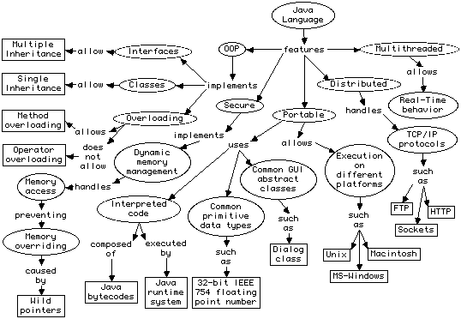
Concept Map Example
P. Conrad (2006) - https://www1.udel.edu/CIS/474/pconrad/06S/topics/pbl/ConceptMapping/intoToConceptMapping.htm

Slide 6
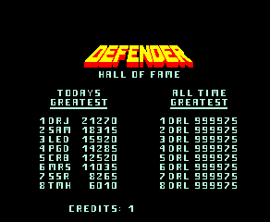
Problem Scenario - Think about...
You have:
players = ["Tom", "Sara", "Leo", "Mina"] scores = [150, 200, 120, 180]
Tasks:
Find the highest score
Print the name of the winner
Find the rank of a given player

Slide 7
Advanced Arrays & Lists
We will covered some Array Theory and then look at Lists in Python

Slide 8
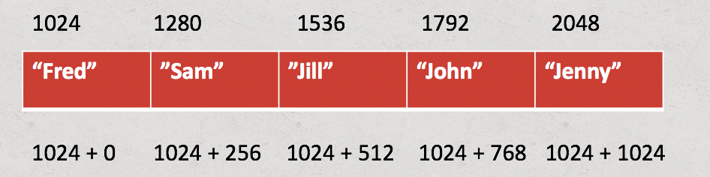
Arrays in Concept
What happens when we store an array of 5 strings in memory?
We can store each of these items sequentially in the memory.
Image Source – Ed Lessons Week 6

Slide 9
Arrays in Concept
What are the limitations with this? Can anyone figure it out?
Keep in mind traditionally arrays have a fixed size. (Python Lists are dynamic, we will explain this later)
We have a fixed size taken up in the memory.

Slide 10
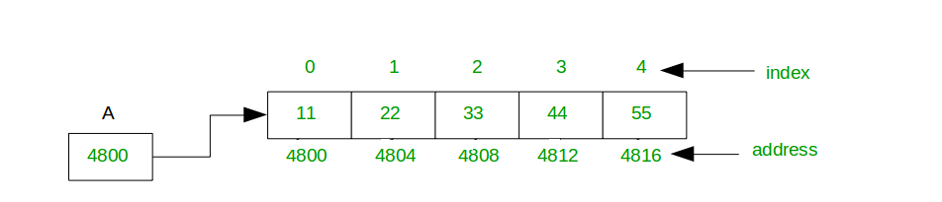
Arrays in Concept – Static vs Dynamic
A static array takes up a fixed amount of memory space, it's allocated continuous space for multiple variables of a given type.
Image Source - https://www.geeksforgeeks.org/dsa/how-do-dynamic-arrays-work/

Slide 11
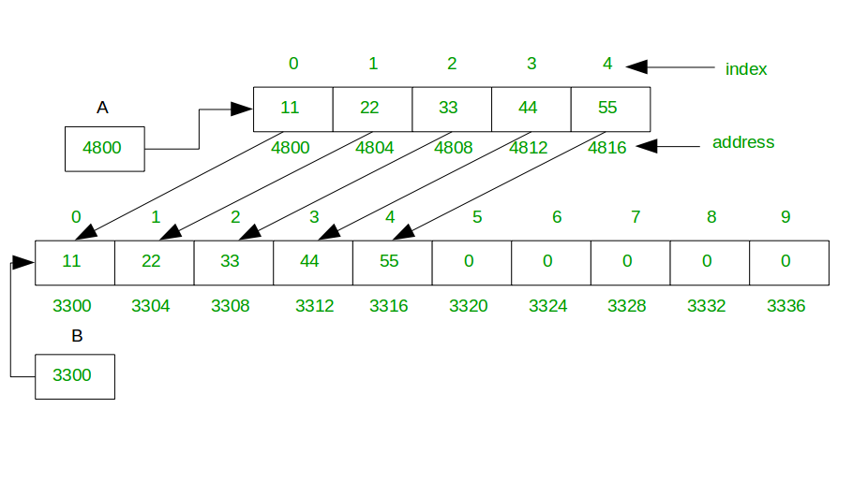
Arrays in Concept – Static vs Dynamic
A dynamic array will automatically copy the array to a new larger one and update as needed.
Image Source - https://www.geeksforgeeks.org/dsa/how-do-dynamic-arrays-work/

Slide 12
Arrays in Concept - Dangers
When we access an array it's possible to go out of bounds. When we do this, it can cause our program to crash, or even worse access data from memory elsewhere and cause unexpected behaviour.

Slide 13
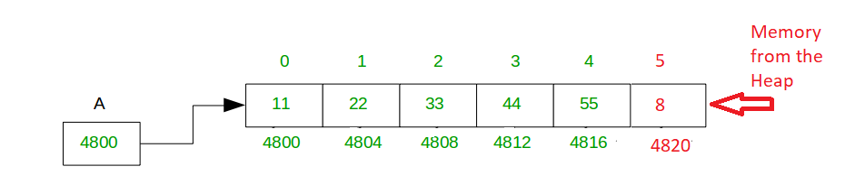
Arrays in Concept - Dangers
Accessing this memory address in C could return an unrelated value!
Image Source - https://www.geeksforgeeks.org/dsa/how-do-dynamic-arrays-work/

Slide 14
Arrays in Concept – 2D Arrays
What do you imagine when you think of 2D arrays?
We can have an array of arrays to create a 2D array.
What might this be useful for?

Slide 15
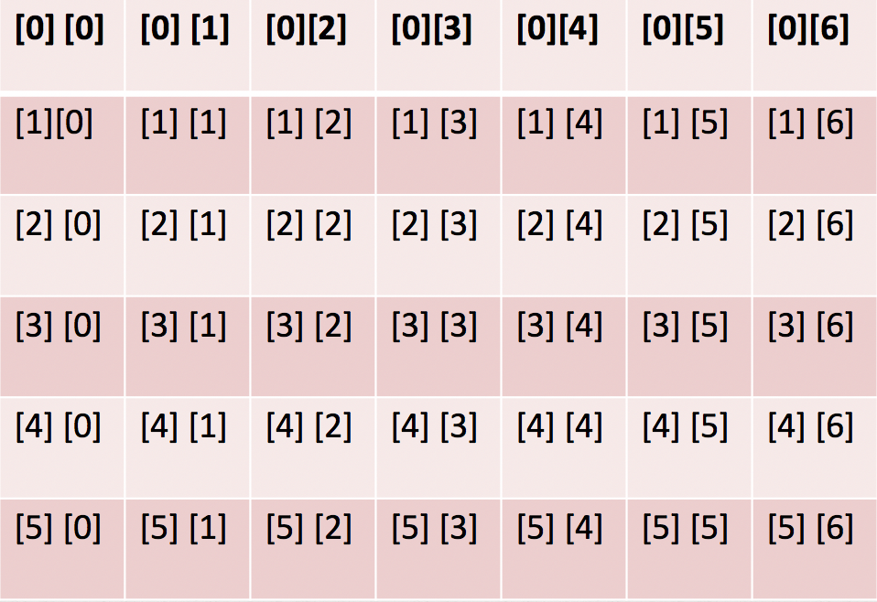
Arrays in Concept – 2D Arrays
Image Source – Ed Lessons Week 6

Slide 16
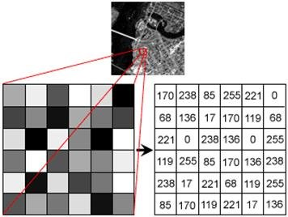
Arrays in Concept – 2D Arrays
Image Source - Neves, António & Barbosa, Bruno & Soares, Sandra & Dimas, Isabel. (2018). Analysis of Emotions From Body Postures Based on Digital Imaging.

Slide 17
Python Lists
Lets look at some of the features in Python Lists
Lists in Python are dynamic and automatically handled by the Python Memory Manager
Keep in mind in other programming languages arrays you might need to manage the memory allocation of arrays yourself.

Slide 18

Lists are ordered

Slide 19

Lists are Mutable (Changeable)

Slide 20
Lists allow duplicates

Slide 21
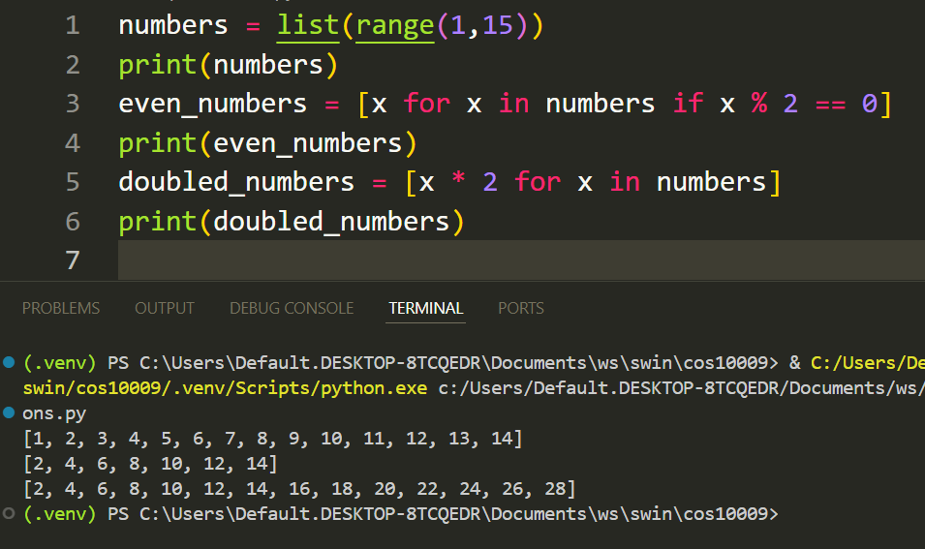
List Comprehensions

Slide 22
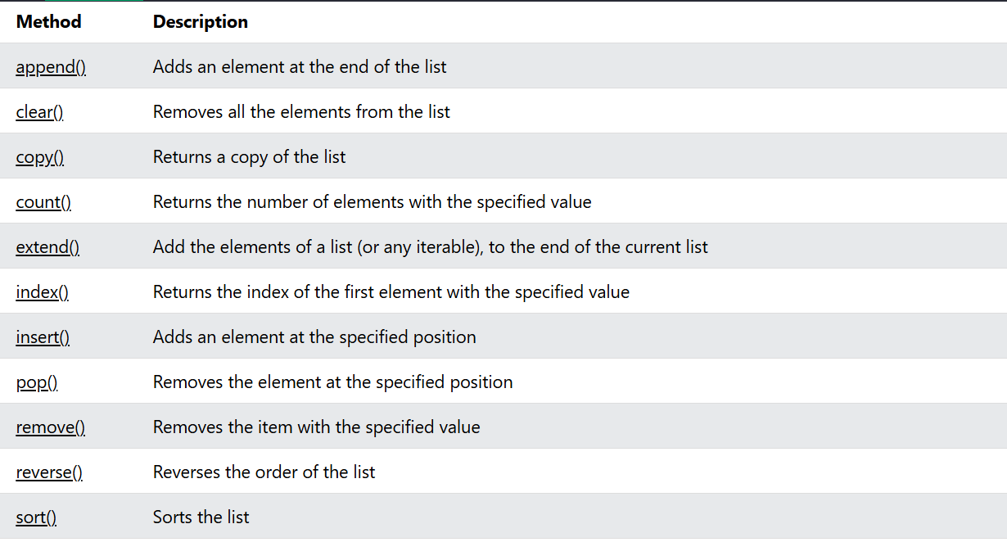
List Methods
https://www.w3schools.com/python/python_lists_methods.asp

Slide 23
Searching Arrays - Theory
When an array has lots of data in it, we need to think about how we might find an item in it?
What if we want to find a specific user from a list of users?
Search for a score in a list of scores?
We need to implement a function to search the list.

Slide 24
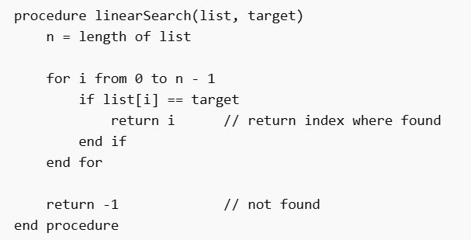
Linear Search - Pseudocode

Slide 25
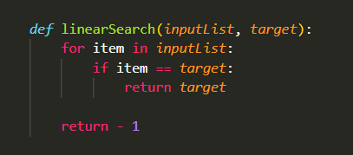
Linear Search - Implementation

Slide 26
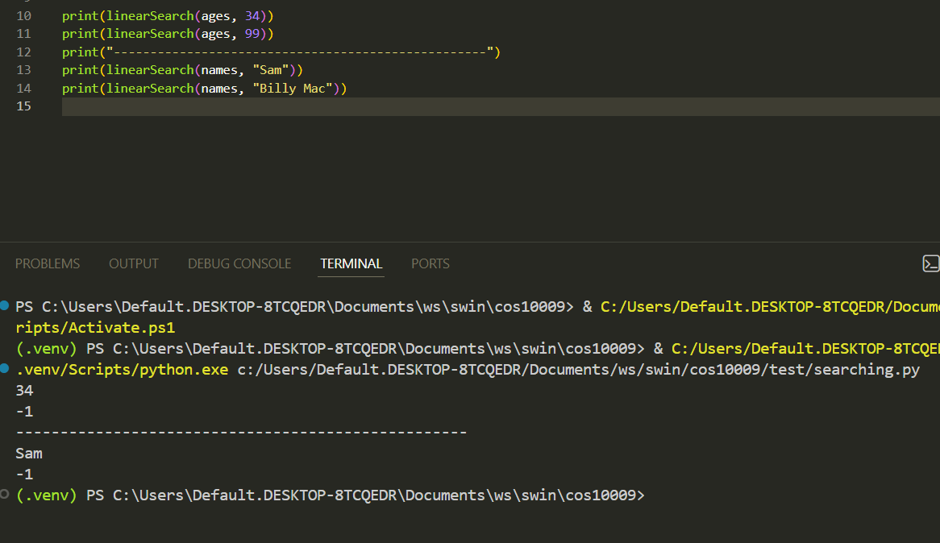
What are some problems with this implementation?

Slide 27
Binary Search
I am thinking of a number between 1 and 100. Everytime you guess I will tell you if the number is higher or lower
Try to guess what I am thinking of?
How many guesses does it take?

Slide 28
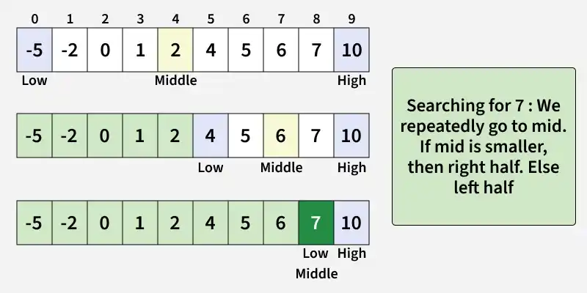
Binary Search - Theory
Source: https://www.geeksforgeeks.org/dsa/binary-search/

Slide 29
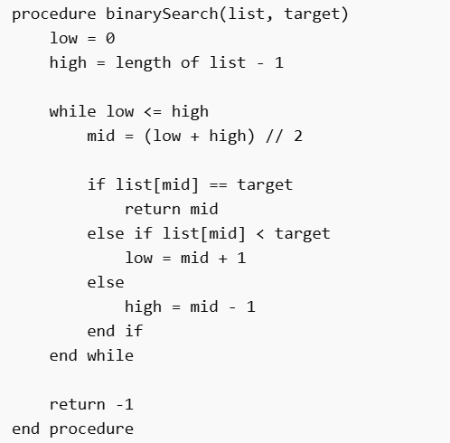
Binary Search – Bonus
Try to implement your own Binary Search algorithm using this pseudocode
Keep in mind the list must be pre-sorted. We will cover sorting in Week 9 so just use a pre-sorted list for now.

Slide 30
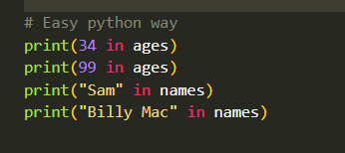
Searching Arrays - Python
Also see: Lecture for W6 and the accompanying code.

Slide 31
Pointers, stack & heap - Theory
We're going to look at what happens under the hood of the memory in the computer when a program runs.
This is very important to know when working with low level languages like C or Rust.
We will study it anyway because it is useful to know, but the Python Memory Manager will handle it behind the scenes when writing python programs.

Slide 32
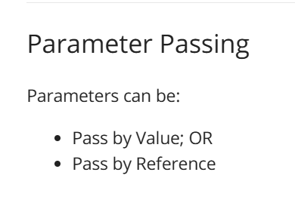
Parameter Passing

Slide 33
Pass By Value
Pass by value takes a copy of the variable and passes it to the called function or procedure:
The original value is unchanged, a copy is made in the memory.
Can be slower, have overhead for large copies.

Slide 34
Pass by Reference
Instead of making a copy, the memory address of the original is passed to the function.
Changes made to the data change the original. There is no backup.
Faster for large objects but is less safe.

Slide 35
Python uses Pass by Object Reference
In Python we pass not by reference or by value.
In python everything is an object. Objects can be Mutable (changing) or Immutable (unchanging)
Int, str, float etc are examples of Immutable data.
Lists, objects are examples of mutable data.

Slide 36
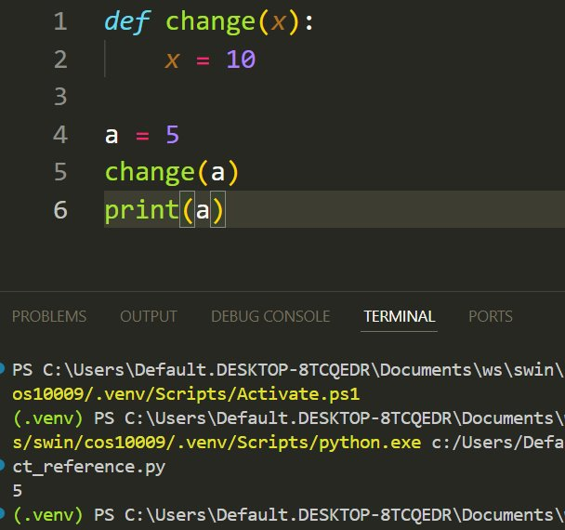
Python Immutable Example

Slide 37
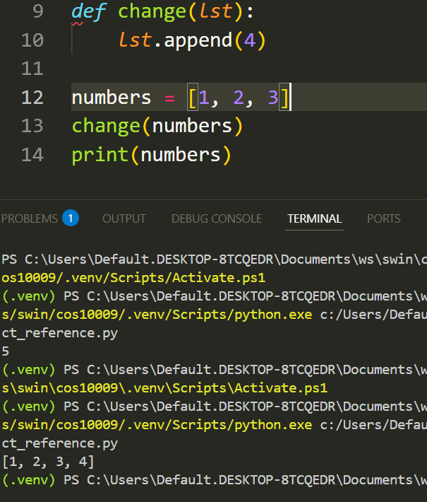
Python Mutable Example

Slide 38
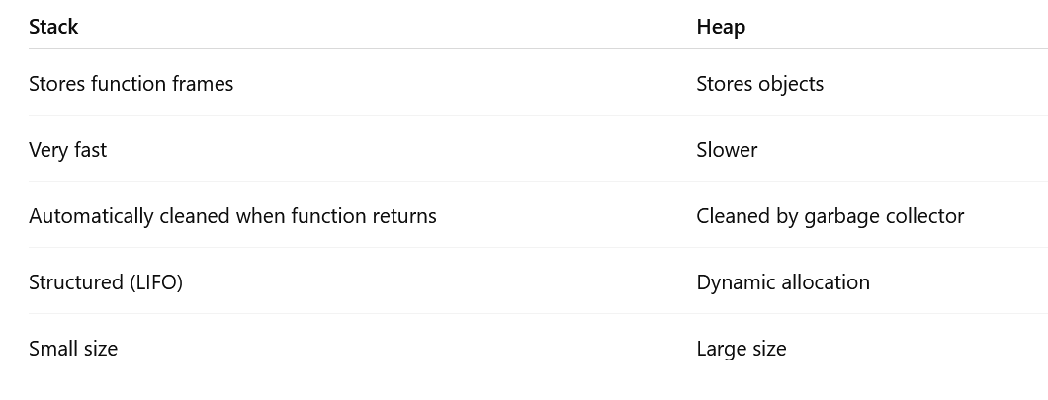
Stack & Heap

Slide 39
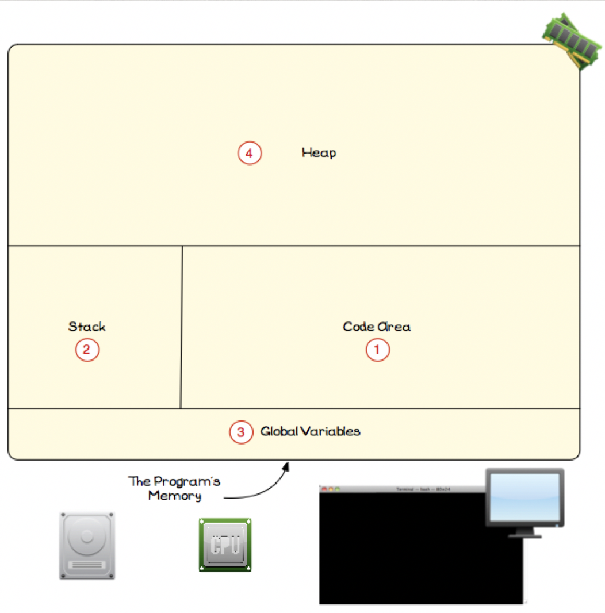
Memory Diagram

Slide 40
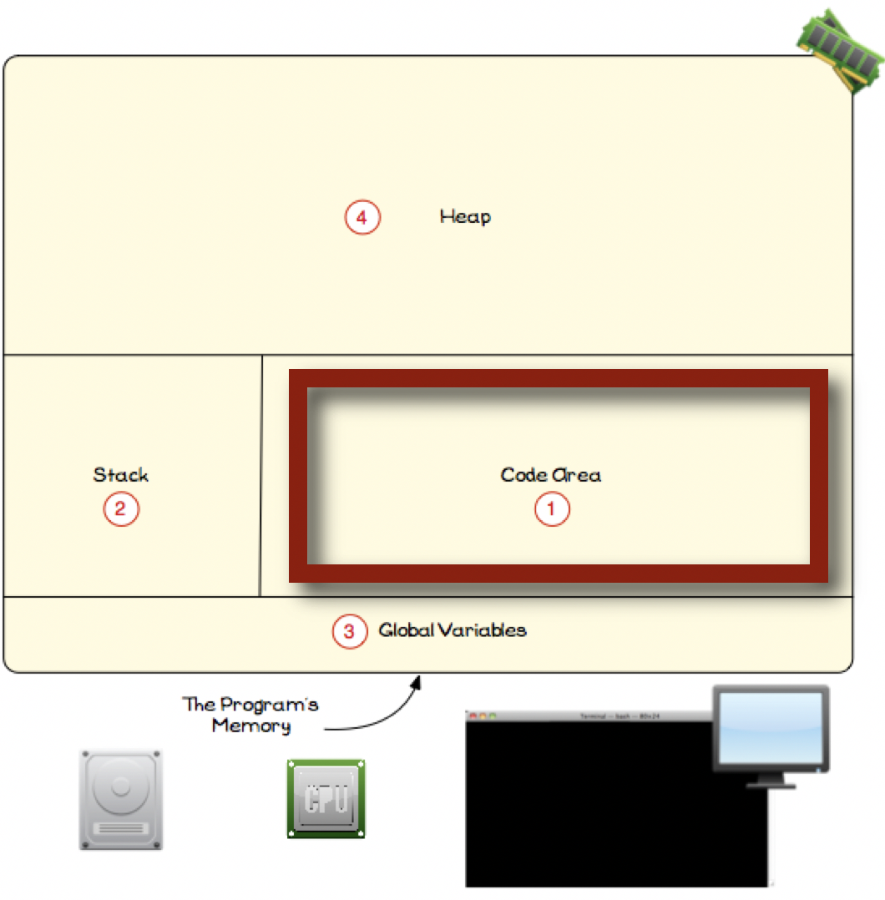
Memory Diagram – Code Area

Slide 41
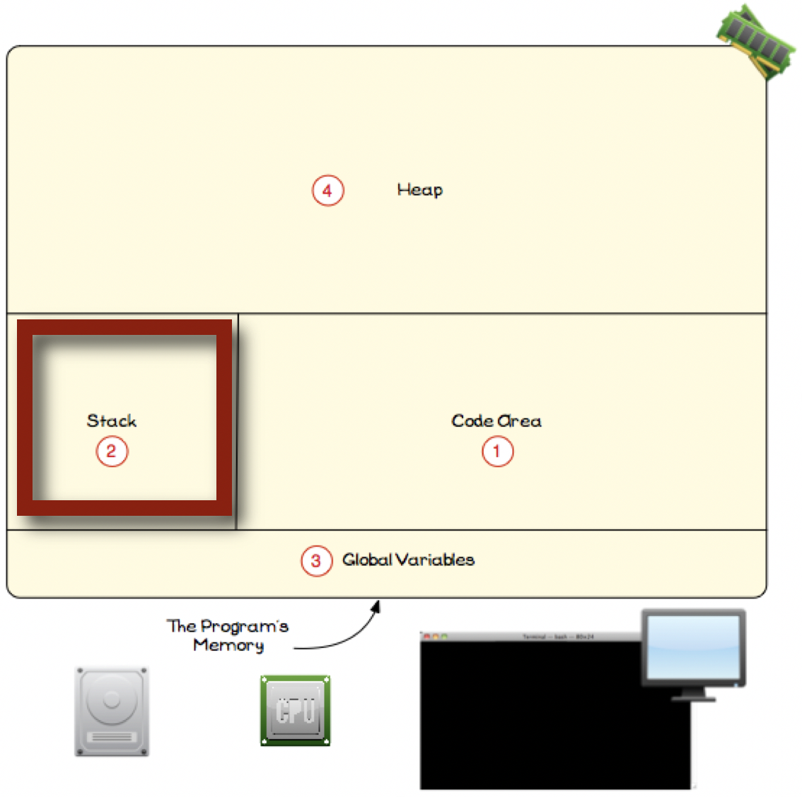
Memory Diagram - Stack

Slide 42
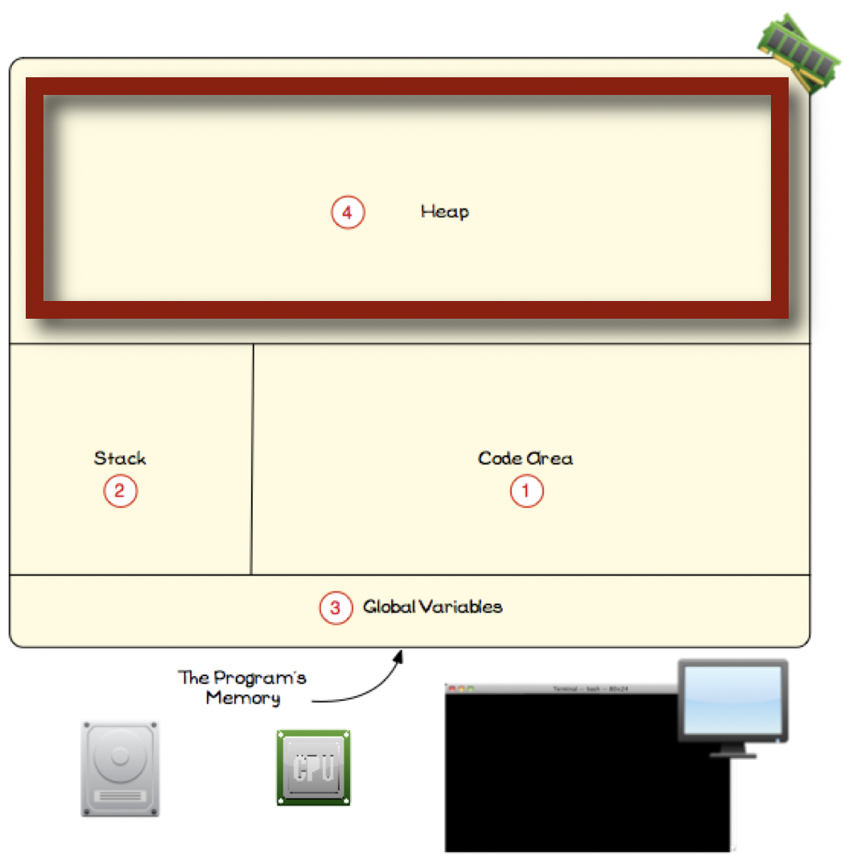
Memory Diagram - Heap

Slide 43
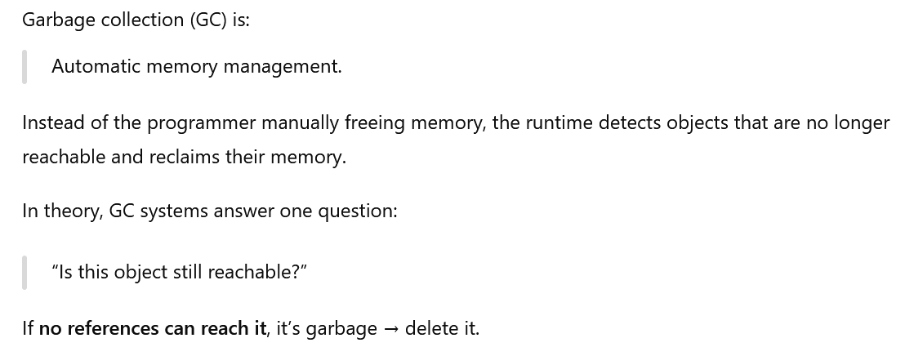
Garbage Collection - Theory

Slide 44
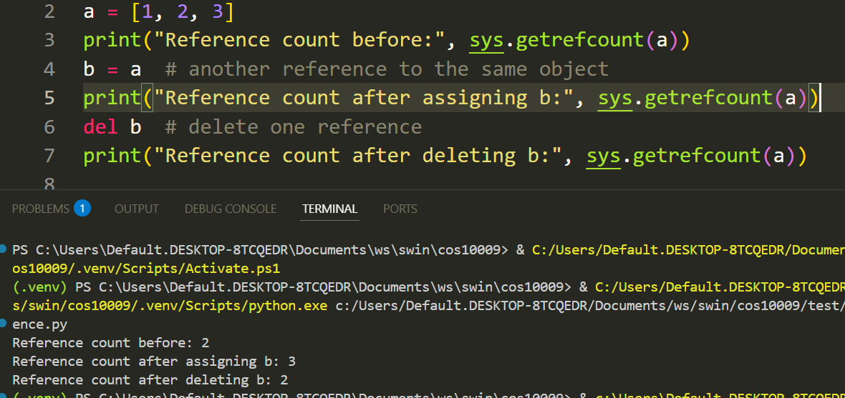
Garbage Collection Python
Python used a Garbage Collector to free up memory when no references to the data exist. It's automatic and behind the scenes.
You don't need to manually delete a reference to an object unless you want to free up the space.
Please note del doesn't delete it from memory, it deletes the reference so the GC will clean it up later.

Slide 45
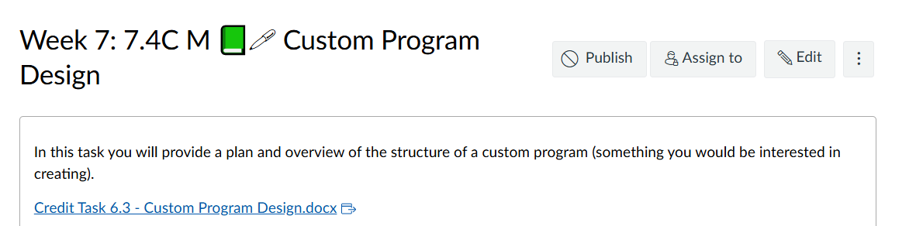
Custom Project Design
It's time to start thinking about the design of your Custom Program. If you are unsure about what you want to do please reach out.

Slide 46
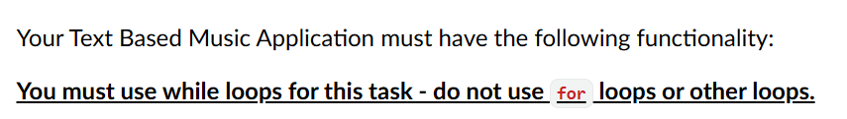
Upcoming Week 9
Music player submission
This is a major task, you will have to demonstrate and explain your code in order to pass.
You MUST use While loops only for this task and will not pass if you use any other kind.

Slide 47
Problem Scenario - Can you solve it?
You have:
players = ["Tom", "Sara", "Leo", "Mina"] scores = [150, 200, 120, 180]
Tasks:
Find the highest score
Print the name of the winner
Find the rank of a given player

